Slide 1






DataCool

Slide 2
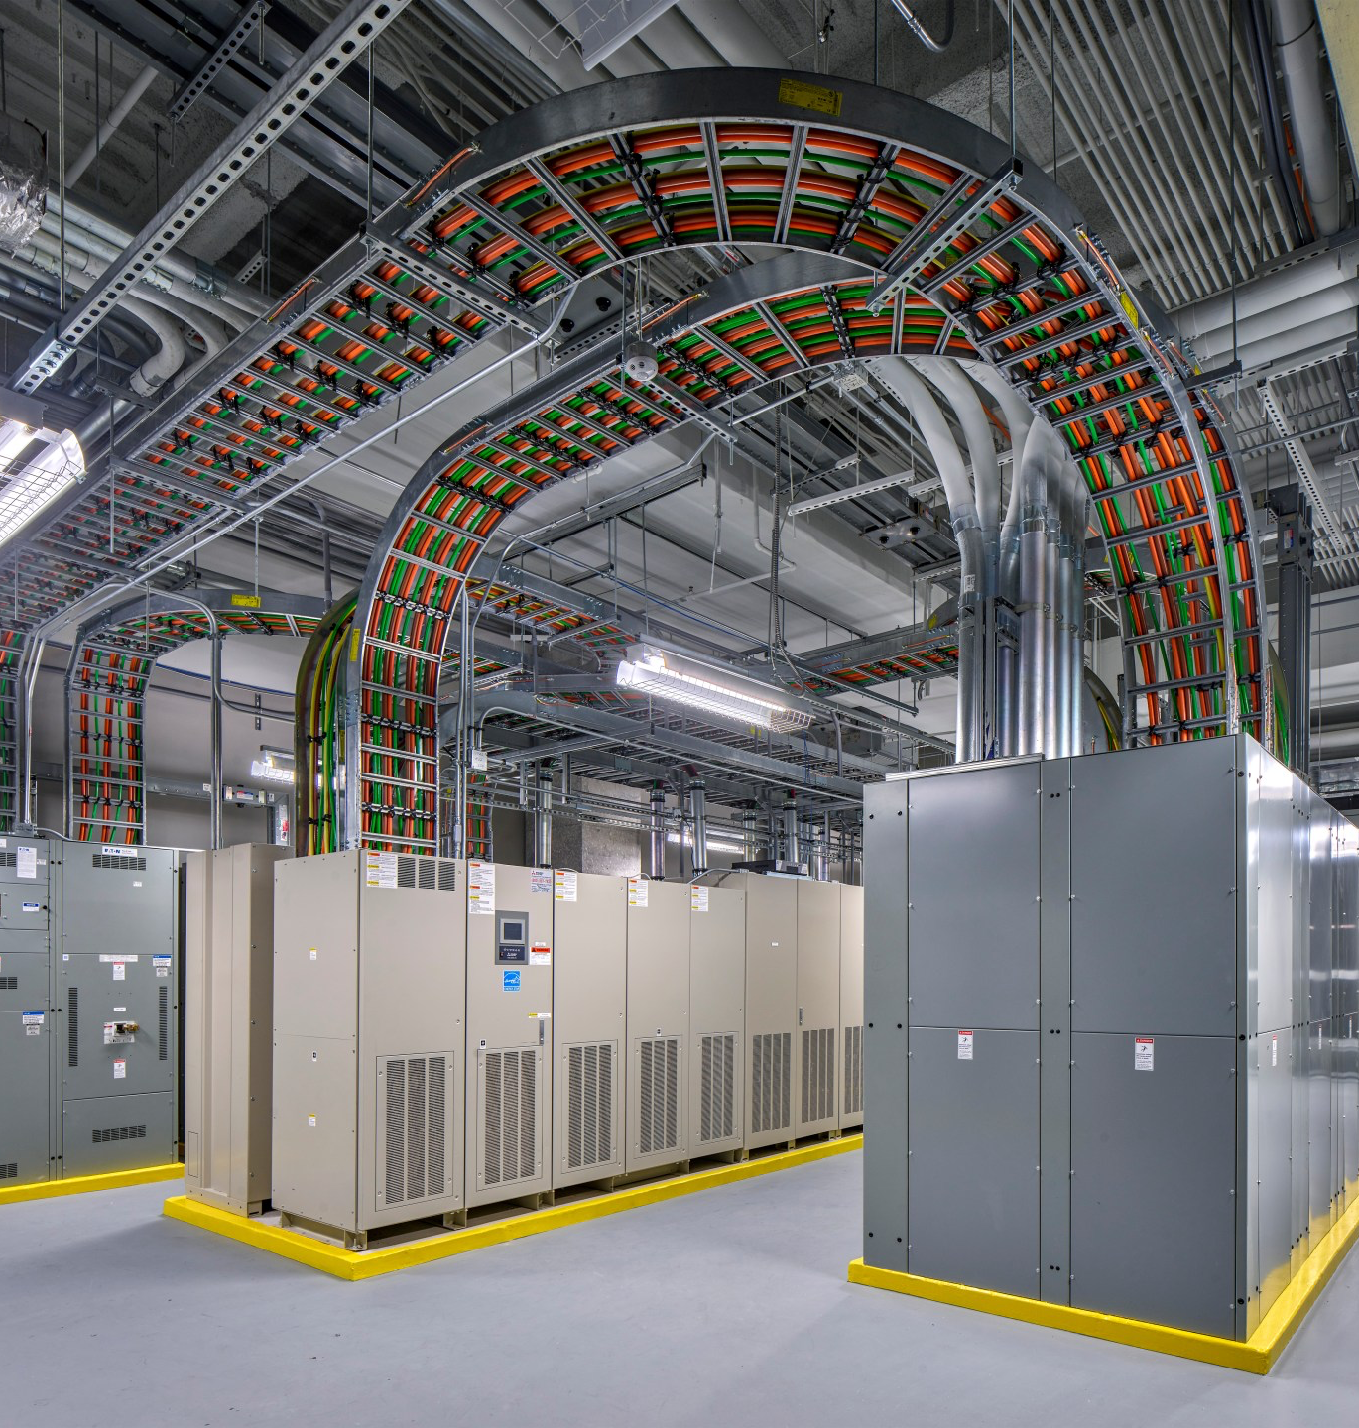
Data Center Energy Crisis
Massive Energy Consumption:
2% of global electricity.
Explosive Compute Growth:
10x increase in computational power needs.
High Peak Costs:
Energy prices up to 3x higher.
Inefficient Scheduling:
Current workload scheduling systems react.
Sustainability Pressures:
Environmental regulations & mandating.

Slide 3
DataCool Predictive Energy Optimization
Predict Hotspots
Smart Workload Shifting
Real-Time Optimization
Operational Dashboard
DataCool anticipates rack-level thermal hotspots before they occur using ML.
Automatically redistributes workloads to cooler racks & avoiding heat buildup.
Analyzes data to recommend adjustments, reducing peak loads & enhance energy efficiency.
Operators control and visualize performance metrics, AI risk scoring, and recommendations through modern UI.

Slide 4
Three-Step Intelligence Pipeline
02
03
01
Monitor:
Real-Time Data
Predict: AI-Driven Forecasting
Optimize: Autonomous Redistribution:
Sensors continuously collect CPU load, temperature, power draw, and network activity from each rack.
A Random Forest classifier (94% accuracy) predicts thermal hotspots before they occur, allowing risk-aware scheduling.
The system dynamically shifts workloads to cooler or underutilized racks while adhering to operational constraints

Slide 5
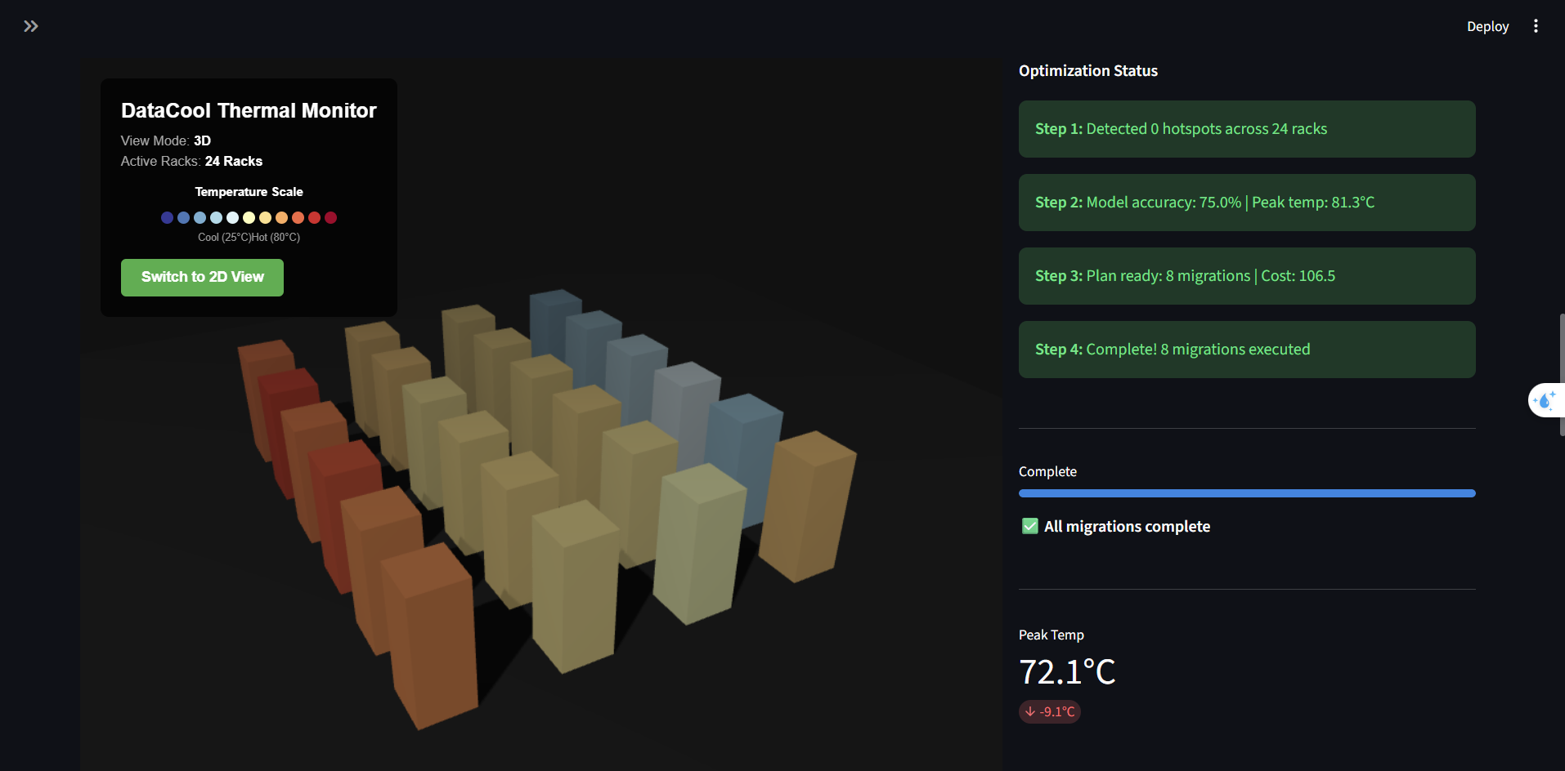
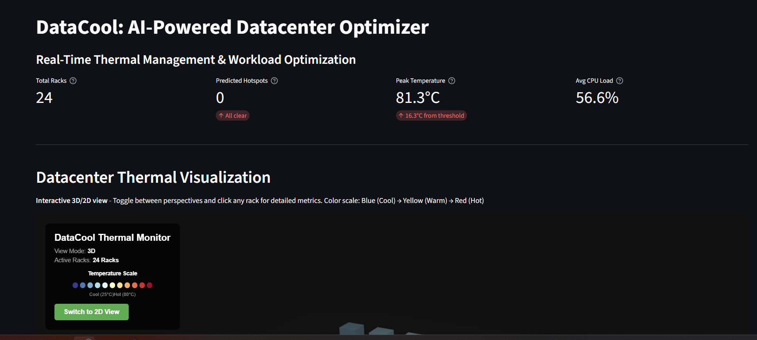
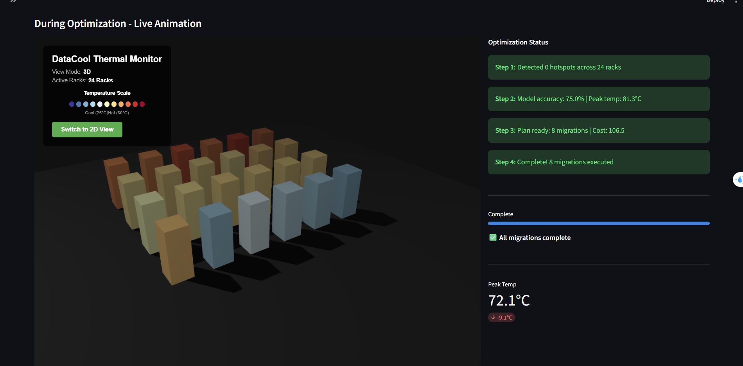
Technology in Action

Slide 6

THANK YOU
Do you have any questions?

